Slide 1
BOOSTING ALGORITHM
V.DIVYA

Slide 2
BOOSTING ALGORITHM
Boosting is an ensemble(a group of items viewed as a whole rather than individual) modelling technique that attempts to build a strong classifier from the number of weak classifiers.
It is done by building a model by using weak models in series.
Advantages of Boosting: Improved Accuracy, Better handling of imbalanced data, Better Interpretability.
Types of boosting:
Adaboost , XGboost, LGboost, etc.,

Slide 3
ADABOOST ALGORITHM:
Adaboost – AdaBoost is a boosting algorithm that also works on the principle of the stagewise addition method where multiple weak learners are used for getting strong learners.
Adaboost combines a lot of weak learners to make strong learners
Explanation:
In the case of AdaBoost, higher points are assigned to the data points which are miss-classified or incorrectly predicted by the previous model. This means each successive model will get a weighted input.

Slide 4
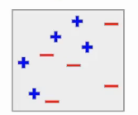
Example:
Let’s understand how this is done using an example.
Here, we have the blue positives and red negatives. Now the first step is to build a model to classify this data.

Slide 5
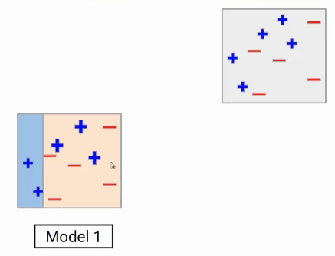
Model1
Suppose the first model gives the following result, where it is able to classify two blue points on the left side and all red points correctly. But the model also miss-classify the three blue points here.

Slide 6
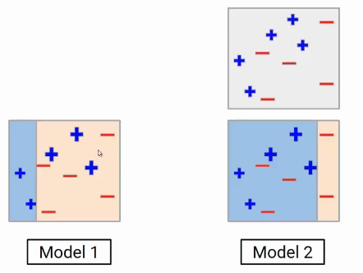
Model 2
Now, these miss- classified data points will be given higher weight next iteration.
In the second model we could see, the model boundary has been shifted to the right side
Still, it’s not a perfect model.
We could notice 3 red negatives are miss-classified by model 2.

Slide 7
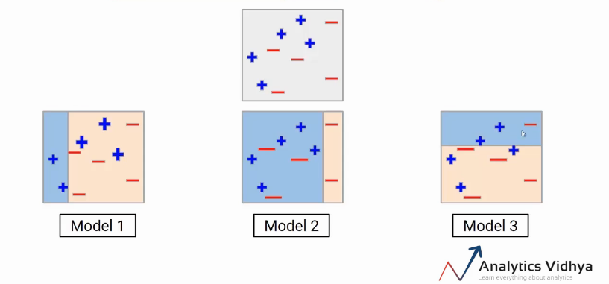
Model 3
The task of the third model is to focus on these three red negative points..
This new model again incorrectly predicted some data points.
At this point, we can say all these individual models are not strong enough to classify the points correctly and are often called weak learners.

Slide 8
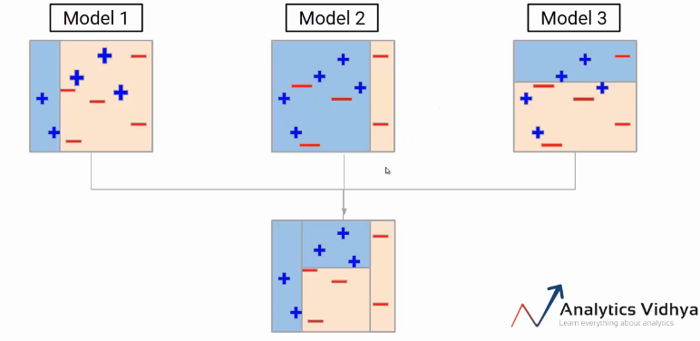
Ensemble
We have to aggregate these models.
So our final model will be the weighted mean of individual models.

Slide 9
After multiple iterations, we would be able to create the right decision boundary with the help of all the previous weak learners.
This final model is known as a strong learner.
Steps taken in AdaBoost.
Build a model and make predictions.
Assign higher weights to miss-classified points.
Build next model.
Repeat steps 3 and 4.
Make a final model using the weighted average of individual models.

Slide 10
Gradient Boosting Machine (GBM)
A Gradient Boosting Machine or GBM combines the predictions from multiple decision trees to generate the final predictions.
All the weak learners in a gradient boosting machine are decision trees.
The nodes in every decision tree take a different subset of features for selecting the best split.
The individual trees aren’t all the same and hence they are able to capture different signals from the data.
Additionally, each new tree takes into account the errors or mistakes made by the previous trees.

Slide 11
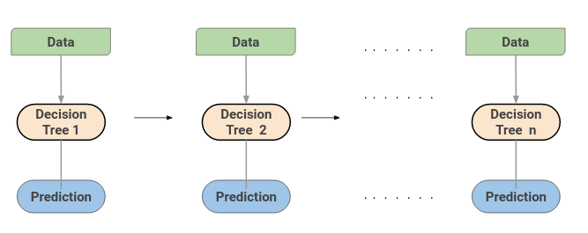
This is how the trees in a gradient boosting machine algorithm are built sequentially.

Slide 12
Extreme Gradient Boosting Machine (XGBM)
XGBoost is simply an improvised version of the GBM algorithm!
XGBoost slightly better than GBM – as below:
XGBM implements parallel preprocessing (at the node level) which makes it faster than GBM
Includes a variety of regularization techniques that reduce overfitting and improve overall performance.
It can select the regularization technique by setting the hyperparameters of the XGBoost algorithm. The XGBM model can handle the missing values on its own.
During the training process, the model learns whether missing values should be in the right or left node.

Slide 13
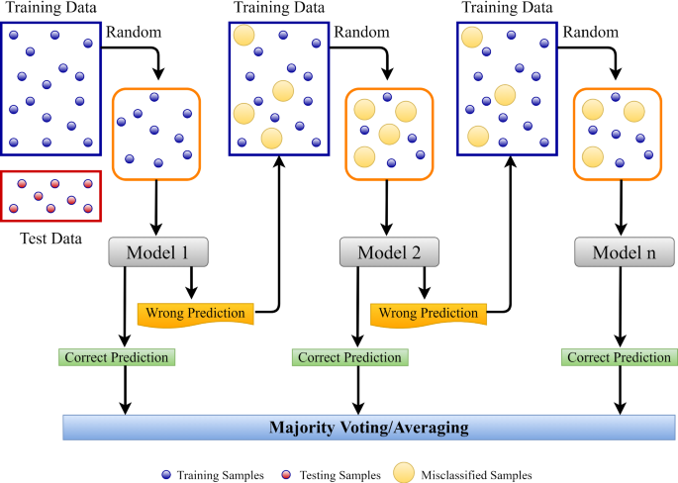

Slide 14
LightGradientBoosting Algorithm
The LightGBM boosting algorithm is becoming more popular by the day due to its speed and efficiency
LightGBM is able to handle huge amounts of data with ease.
But, this algorithm does not perform well with a small number of data points.
The trees in LightGBM have a leaf-wise growth, rather than a level-wise growth.
After the first split, the next split is done only on the leaf node that has a higher delta loss.

Slide 15
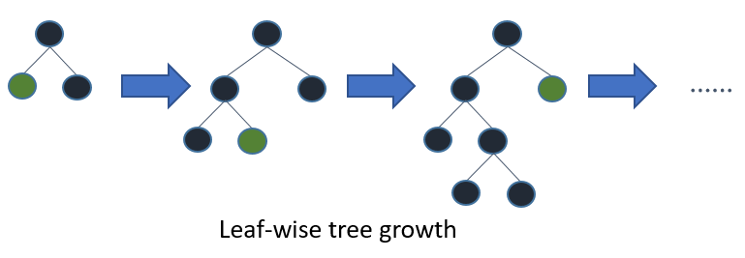
After the first split, the left node had a higher loss and is selected for the next split.
Now, we have three leaf nodes, and the middle leaf node had the highest loss.
The leaf-wise split of the LightGBM algorithm enables it to work with large datasets.

Slide 16
In order to speed up the training process, LightGBM uses a histogram-based method for selecting the best split.
For any continuous variable, instead of using the individual values, these are divided into bins or buckets.
This makes the training process faster and lowers memory usage.
--END--

